Slide 1


Subject Code: SIT-1401
Subject Name: Human Computer Interaction
Faculty Name: Dr.R.Jeberson Retna Raj

Slide 2
AGENDA
SIT1401 Human Computer Interaction Syllabus
Suggested Books
Roadmap to Unit I
First Topic: The Human: I/O channels
Memory - Reasoning and problem solving
The computer:
Devices
Memory

Slide 3
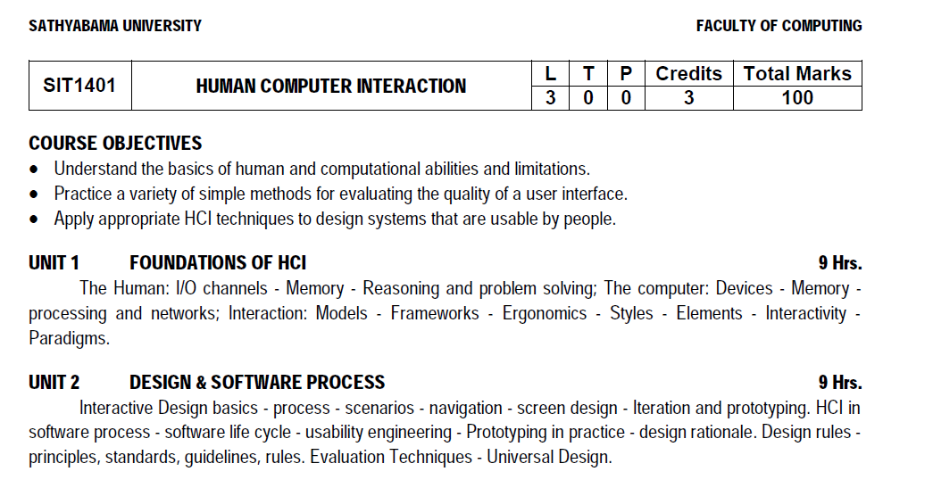
Syllabus

Slide 4
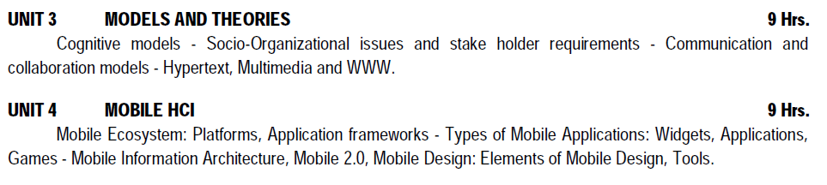
Syllabus

Slide 5
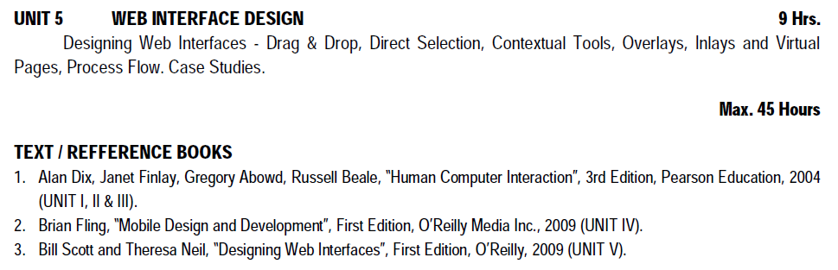
Syllabus

Slide 6
Course Outcomes
On completion of the course, student will be able to:
CO1: Identify various interaction models and styles for designing a web application.
CO2: Design a web application based on design rules.
CO3: Relate the web application with the cognitive models.
CO4: Construct a mobile application based on mobile design and development framework.
CO5: Prototype any web application using web interface design guidelines.
CO6: Create custom design for any web and mobile applications.

Slide 7
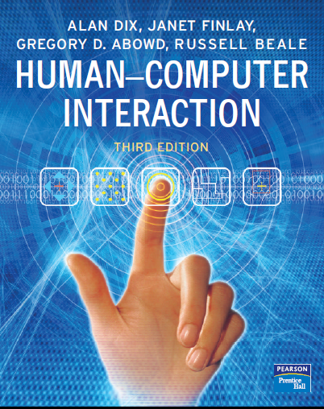
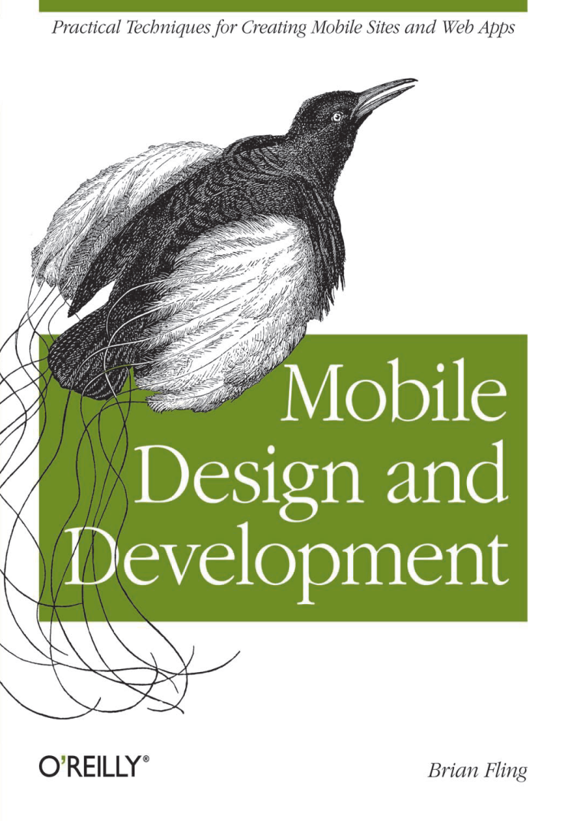

Books

Slide 8
Roadmap to Unit 1 – INTRODUCTION
The Human: I/O channels
Memory - Reasoning and problem solving
The computer:
Devices
Memory
processing and networks;
Interaction:
Models
Frameworks
Ergonomics
Styles
Elements
Interactivity
Paradigms.

Slide 9
Outline
Early Human Computer Interaction
Development of HCI
Interaction Paradigms
Types of user interfaces
Disciplines contributing to HCI
Aim-Approach for this course

Slide 10
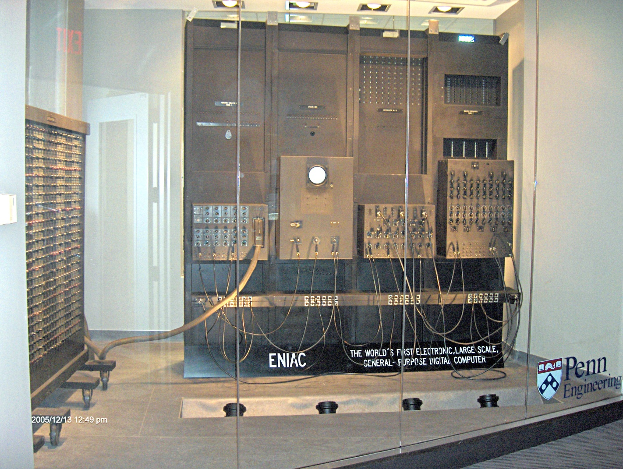

Computing in 1943
First Electronic Numerical Integrator and Computer (ENIAC -1943)
Contains 20,000 vacuum tubes;
7,200 crystal diodes;
1,500 relays;
70,000 resistors;
10,000 capacitors;
and approximately 5,000,000 hand-soldered joints.

Slide 11
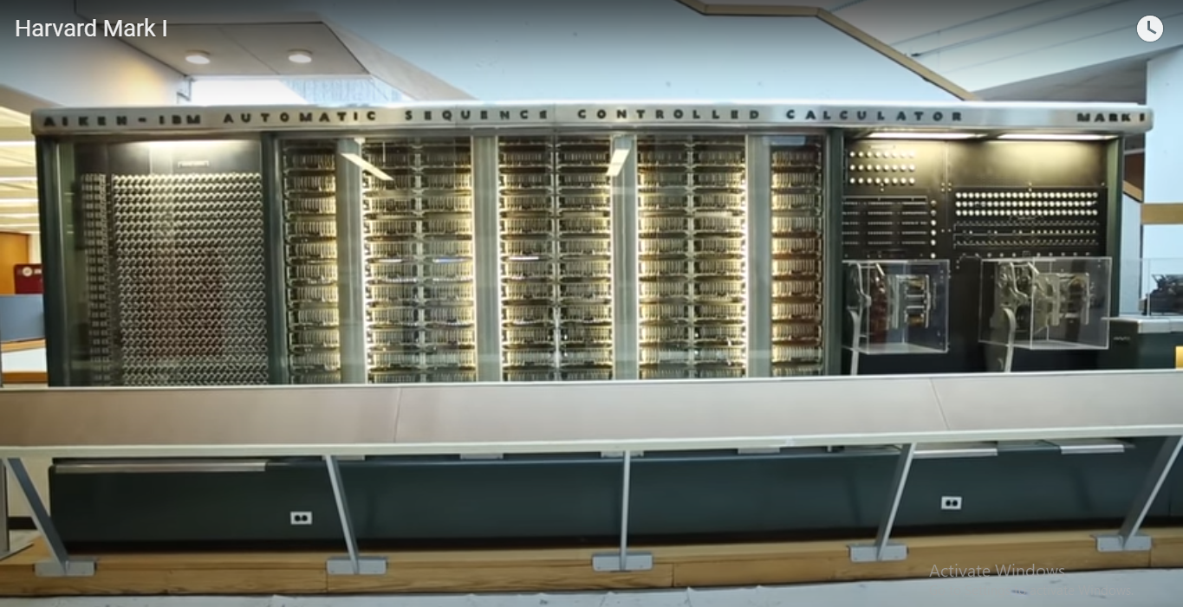
Computing in 1945
Harvard Mark I (1944)
ASCC: IBM Automatic Sequence Controlled Calculator (aka Mark 1)
55 feet long, 8 feet high, 5 tons

Slide 12
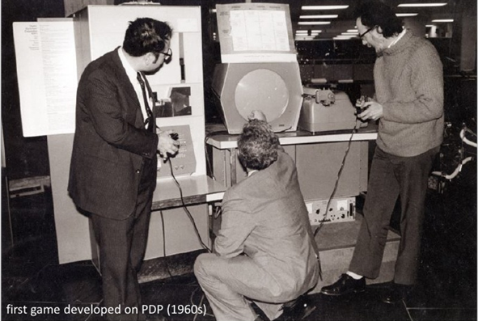
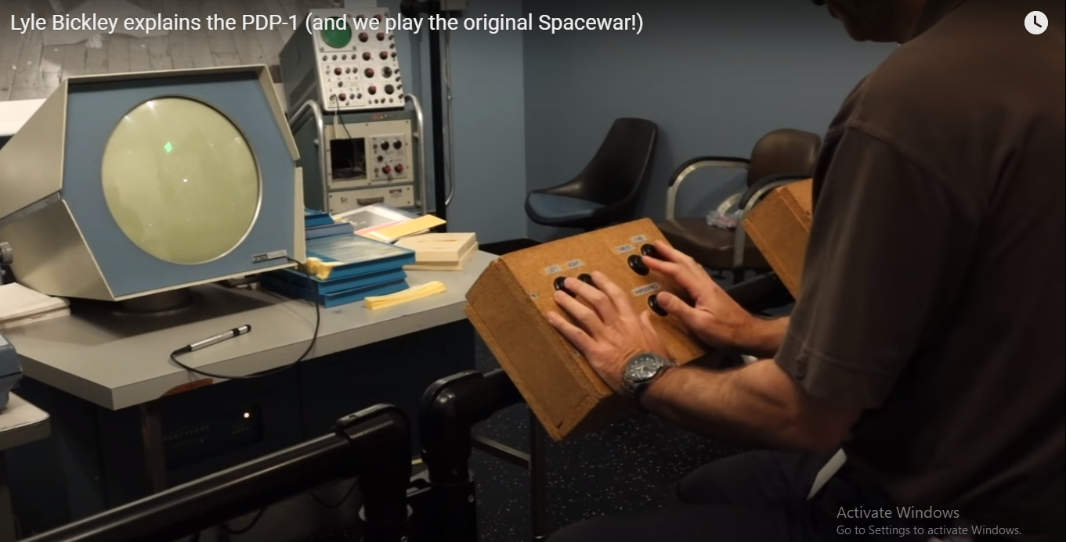
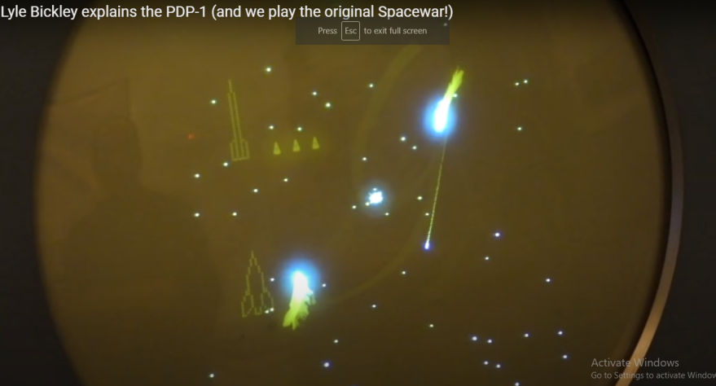
First game on PDP (Programmed Data Processor) in 1960

Slide 13
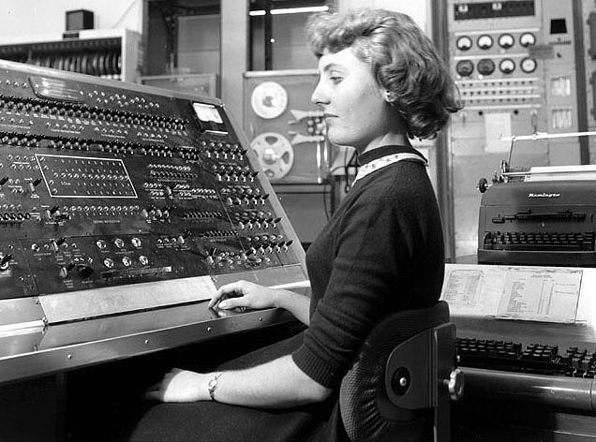
Early Human Computing Interaction

Slide 14
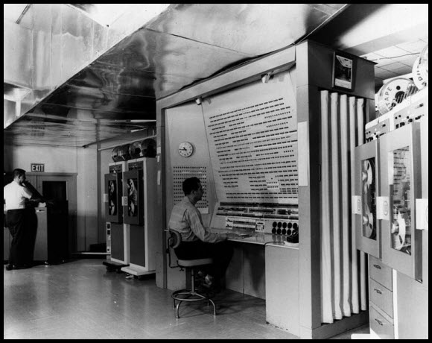
Early Human Computing Interaction

Slide 15
What Interactions Did We See?
Mechanical
Poor feedback
Specialist use
Process control
Calculations
No intention to address the mass market

Slide 16

Computing in 1980

Slide 17
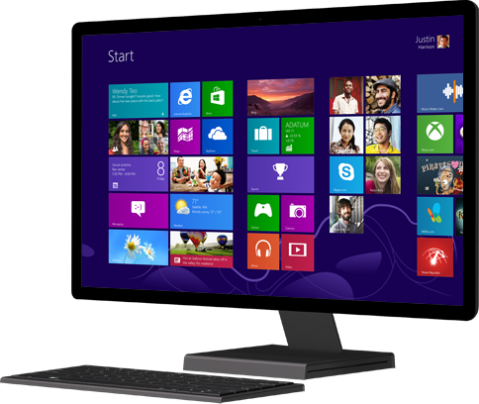
Computing in 2000

Slide 18
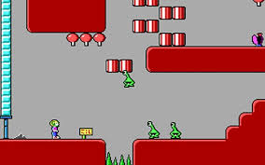
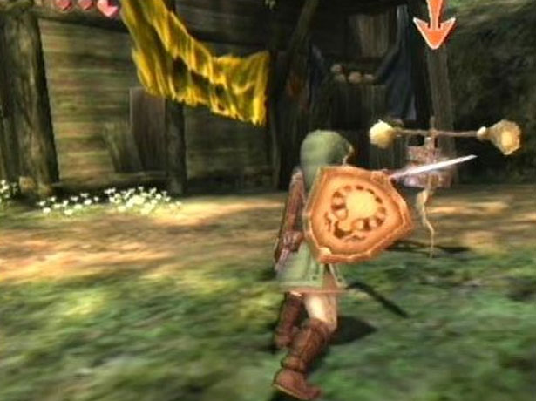
Gaming Interface in 1990

Slide 19
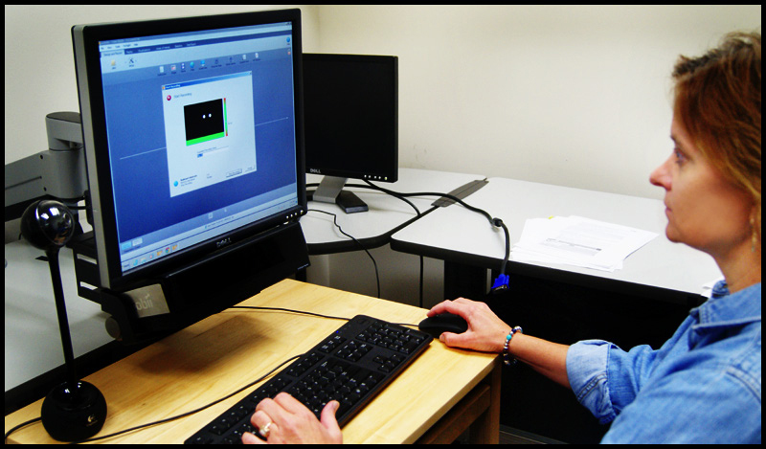
Late Human Computing Interaction

Slide 20

Today Human Computing Interaction

Slide 21

Today Human Computing Interaction

Slide 22
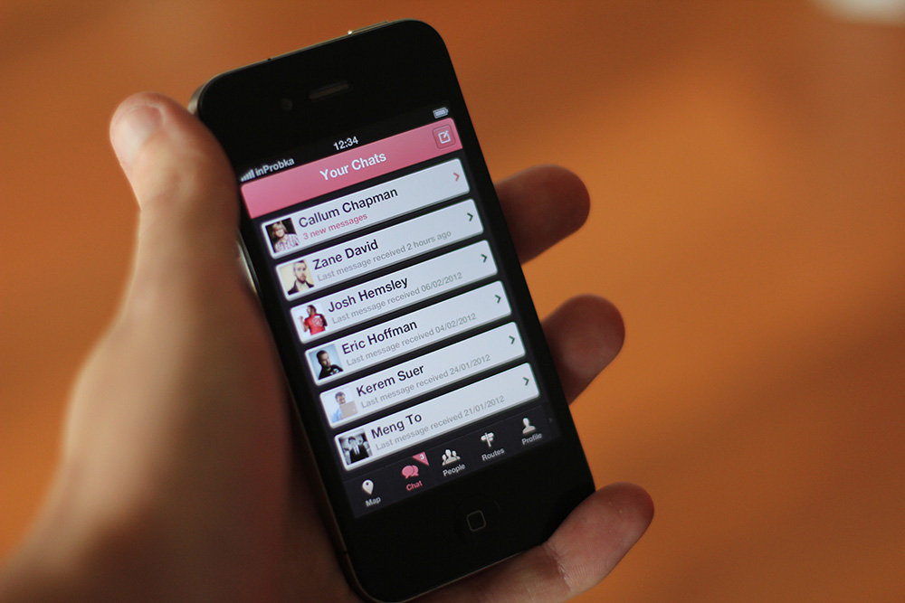
Today Human Computing Interaction

Slide 23
Today Human Computing Interaction
Early computers (1940): extremely difficult to use
Large and Expensive
More time consuming process
Used by specialists
No knowledge about how to make use easier
Late computers (1990): easy to use
None of these conditions hold
Development of PC’s major landmark
Today (2015)-Shift to other interaction paradigms
Small-handheld-Devices
Mobility

Slide 24
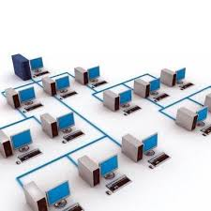

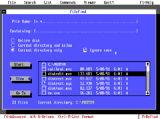
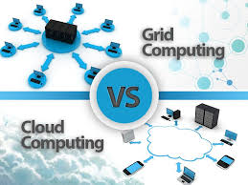
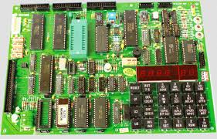
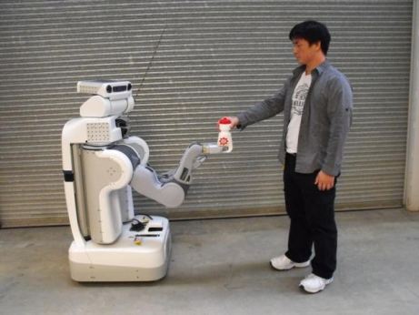
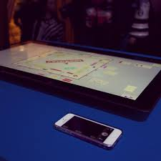
Interaction Paradigms
Batch Processing
Timesharing
Networking (1972 1st email)
Graphical display
Microprocessor
WWW
Grid/Clouds Computing
Human Robot Interaction
Tablet/Table Top Computing
1950’s
1960’s
1970’s
1980’s
1990’s
1995’s
This era …

Slide 25
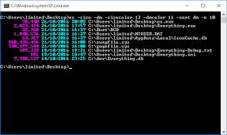
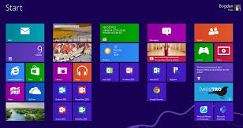
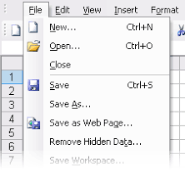
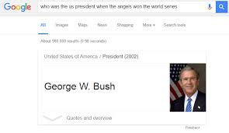
Types of user interfaces
Command Line Interface
Menu Driven Interface
Graphical User Interface
Natural Language Interface

Slide 26
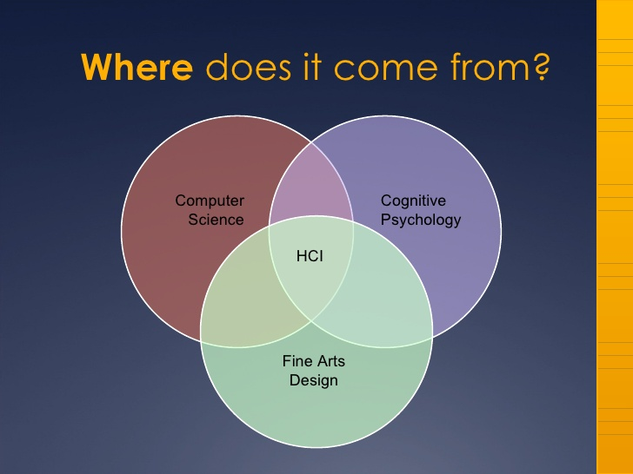
Disciplines contributing to HCI

Slide 27
What is HCI
HCI is the study of interaction between human (users) and computers.
The interaction between user(s) and computer(s) is achieved via an interface – user interface

Slide 28
Definition of HCI
A workable definition is
“A set of processes, dialogues and actions through which a human employs and interacts with a computer”

Slide 29
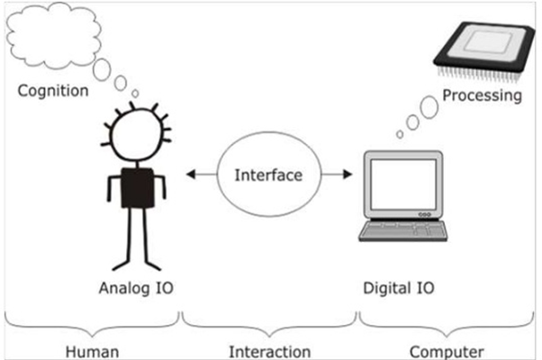
HCI definition

Slide 30

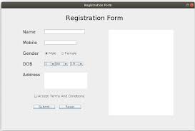
What is HCI
Human
Users, single, group working together, sequence
Users(s) tries to complete a task
Computer
Technology, not just desktop computer
Systems
Large scale computers
Process control
Embedded systems
Interaction
Communication, direct/indirect
Dialogue + feedback / batch
Task oriented

Slide 31
Key concepts of HCI
Usability
Cognetics- locus of attention
Affordance
What sort of operations and manipulations can be done to an object
Crucial is the perceived affordance
Visibility
Mapping between controls and effects should be sensible and meaningful
feedback
Task orientation- fit, analysis

Slide 32
First principle of HCI (Usability)
useful
Accomplish what is required (functional, does things)
usable
Do it easily and naturally without error (does the right things)
used
Make people want to use it (be attractive, acceptable to organization)

Slide 33
Why do we need to understand Humans in HCI
Humans are limited in their capacity to process information.
This has important implications for design
Interacting with technology is cognitive
Human Information Processing is referred to as cognition

Slide 34
User Phycology in HCI
Helps identify target for design
Helps explain success or failure of design
Provides little prescriptive guidance for design
Provides prediction of human performance

Slide 35
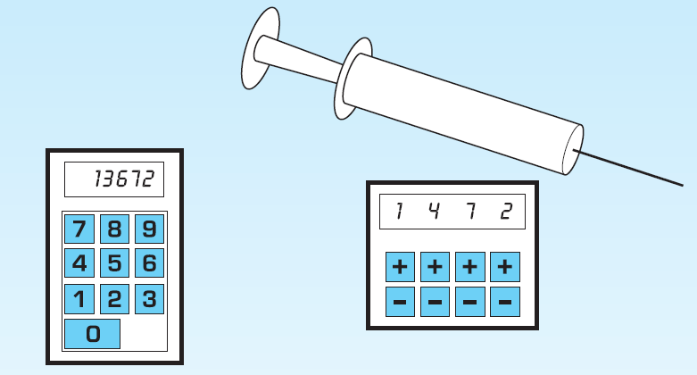
Prototype of mechanical syringe
Example of Participatory design

Slide 36
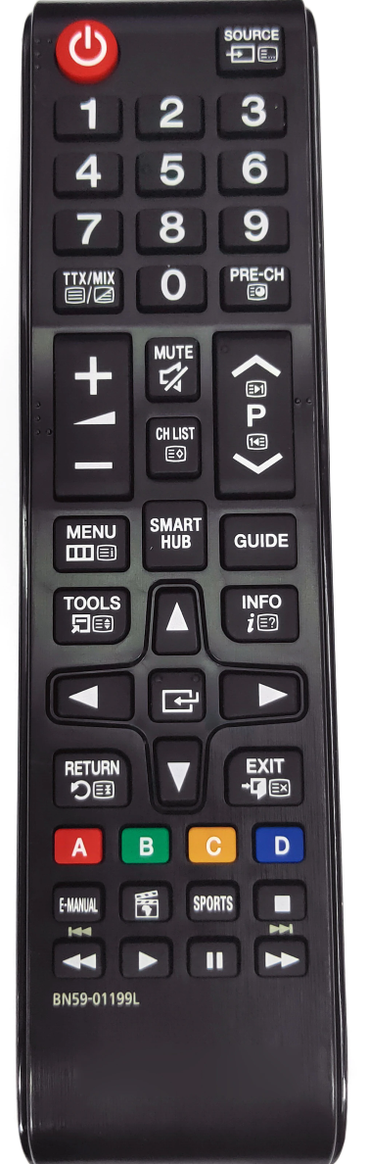
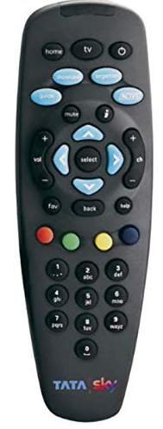
Design

Slide 37
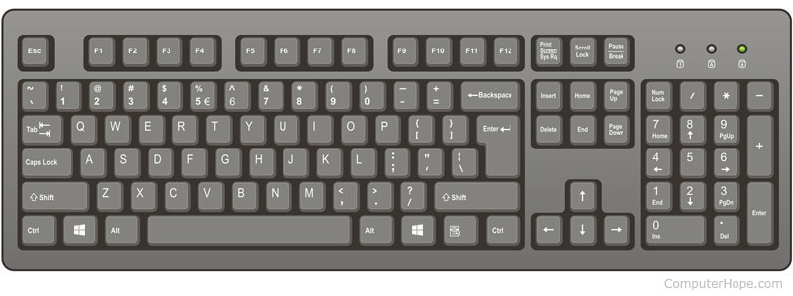
Design

Slide 38
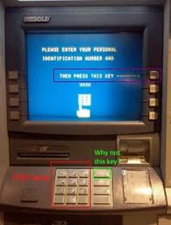
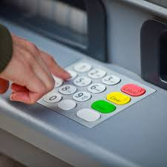
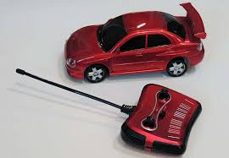
ATM machine

Slide 39
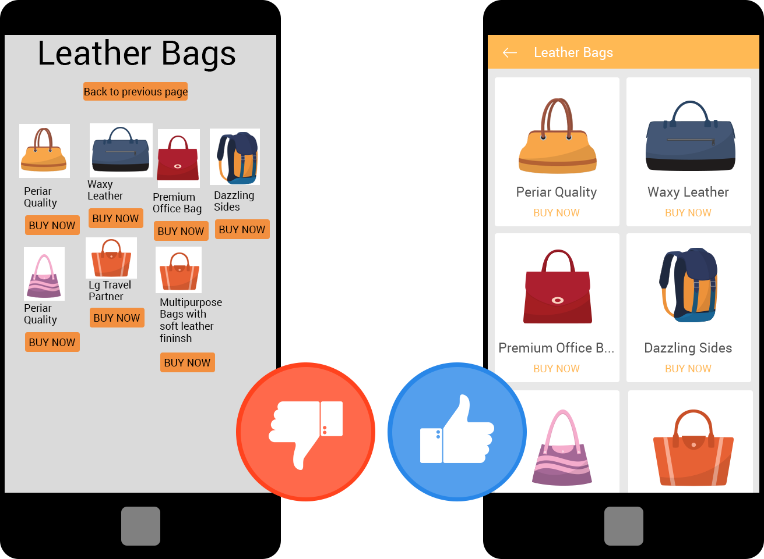
Good design Vs Bad Design

Slide 40
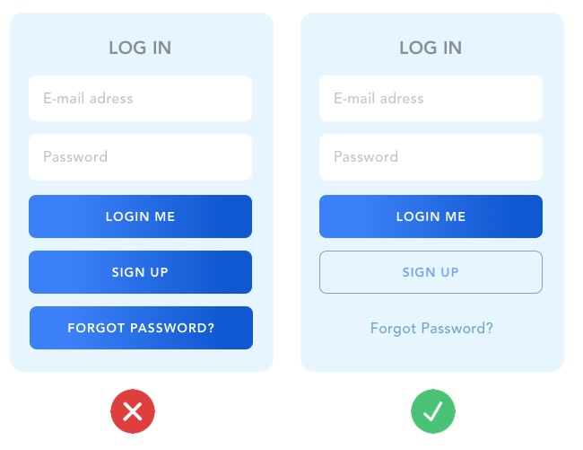
Good design Vs Bad Design

Slide 41
Queries?

Slide 42
The human
Information i/o …
visual, auditory, haptic, movement
Information stored in memory
sensory, short-term, long-term
Information processed and applied
reasoning, problem solving, skill, error
Emotion influences human capabilities
Each person is different

